Slide 1
Assignment 3 Custom UI Component
Assignment 3
Student Number: A…
Student Name: …

Slide 2
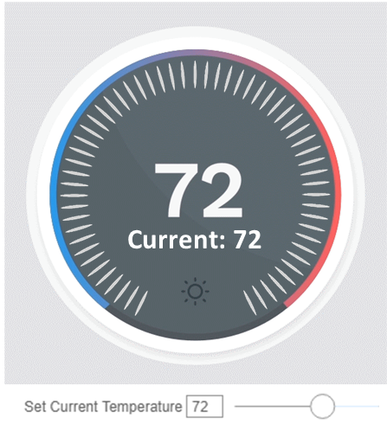
View Tree
MainPanel
DisplayFace
TextDisplay
RadialSlider
DisplayBackground
TargetTemperature
CurrentTemperature

Slide 3
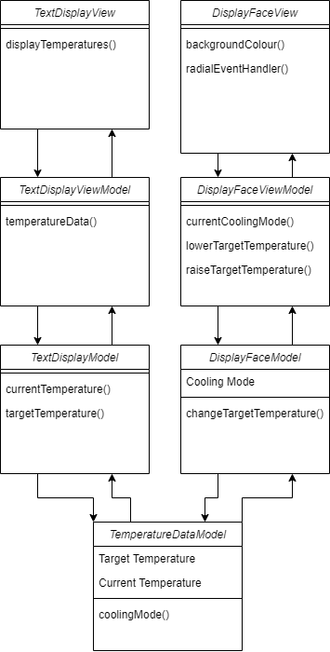
Class Diagrams

Slide 4
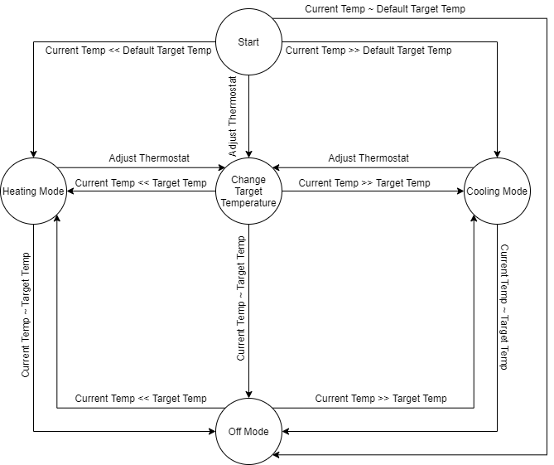
Statechart

Slide 5
Define any Convenience Functions
updateTextBox() – event handler to update textBox state to whatever is in the text box on any change
updateCurrentTemp() – updates current temperature to whatever value between 32 and 100 in the text box as specified in assignment brief. Other values will return warnings.
State chart implemented with xState with corresponding state changes on events.

Slide 6
Details of Radial Slider
Radial slider was achieved with a combination of mouseDown, mouseUp and mouseMove events. mouseDown and mouseUp were used to toggle the mouseDown(clicked) state. mouseMove would update the radial slider angle and call coolingMode() to update the thermostat mode accordingly.
Angle between cursor and center of dial was calculated using Math.atan2() and used to position the dial pointer
CustomEvent dispatched by document on any mouseUp event, returning current degree value.
Temperatures were restricted to between 50 and 80 by limiting the angle of the slider, as specified in the assignment brief.

Slide 7
Bonus: Overriding Mouse Wheel Scroll
Controlling with the mouse wheel scroll was implemented with the native Javascript wheel event handler on the same DOM of the radial slider.
Pointer position was updated via state by adding numerical value of wheel scroll (using native deltaY component of scroll event) to the current degree angle.

Slide 8
Justifications for Architecture and Technology Choices
The VVM components were all included in one JSX file for ease of sharing of cooling mode and temperature states across both the text and circle rendering functions.
Heavy use of component states was essential in keeping track of various parameters and modes, such as cooling mode, current angle, current state, text box content etc.

Slide 9
Justification: Rendering Challenges and Approach
Use of SVG for the dial was chosen due to native rotate function for SVG objects. This made simulating the rotation visually simpler.
Using a ‘transform’ component state to hold a string value of “rotate(x)” where x is the current degree of rotation made it easier to update the SVG transform element dynamically.

Slide 10
README: project files organization
CS3249_Assignment3/
src/
App.jsx
thermostatMachine.js
State machine using xState
view
MainPanel.jsx
Holds all View and ViewModel functions and components
model
TemperatureDataModel.js
Model for temperature data
Provide more details describing purpose of each file.

